Slide 1


Fundamentals - 1.1 Course Intro
Digital Career Institute

Slide 2
Goal of the Module
Course Kick Off
Get an overview of the course’ structure and characteristics
Introduction to Linux
Know characteristics of Linux
Learn about the Shell

Slide 3
Topics
Course Kick Off
Course Introduction
Technical Setup of the Laptops
Introduction to Linux
Operating Systems
Distributions
Shell (bash)

Slide 4
Introduction to Linux

Slide 5
Operating System
[WIKIPEDIA]: https://en.wikipedia.org/wiki/Operating_system

Slide 6

Operating System
[WIKIPEDIA]: https://en.wikipedia.org/wiki/Operating_system

Slide 7
Operating System
“An operating system (OS) is system software that manages computer hardware,
[WIKIPEDIA]: https://en.wikipedia.org/wiki/Operating_system

Slide 8
Operating System
“An operating system (OS) is system software that manages computer hardware, software resources,
[WIKIPEDIA]: https://en.wikipedia.org/wiki/Operating_system

Slide 9
Operating System
“An operating system (OS) is system software that manages computer hardware, software resources, and provides common services for computer programs.”
[WIKIPEDIA]: https://en.wikipedia.org/wiki/Operating_system

Slide 10
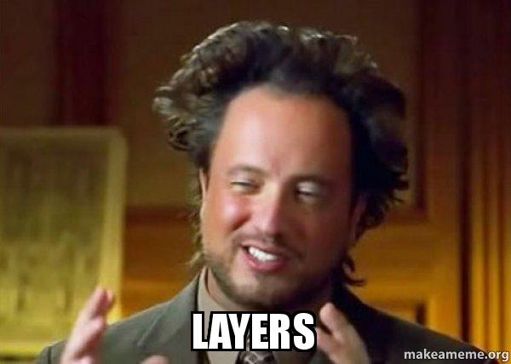
Operating System
“An operating system (OS) is system software that manages computer hardware, software resources, and provides common services for computer programs.”
[WIKIPEDIA]: https://en.wikipedia.org/wiki/Operating_system

Slide 11
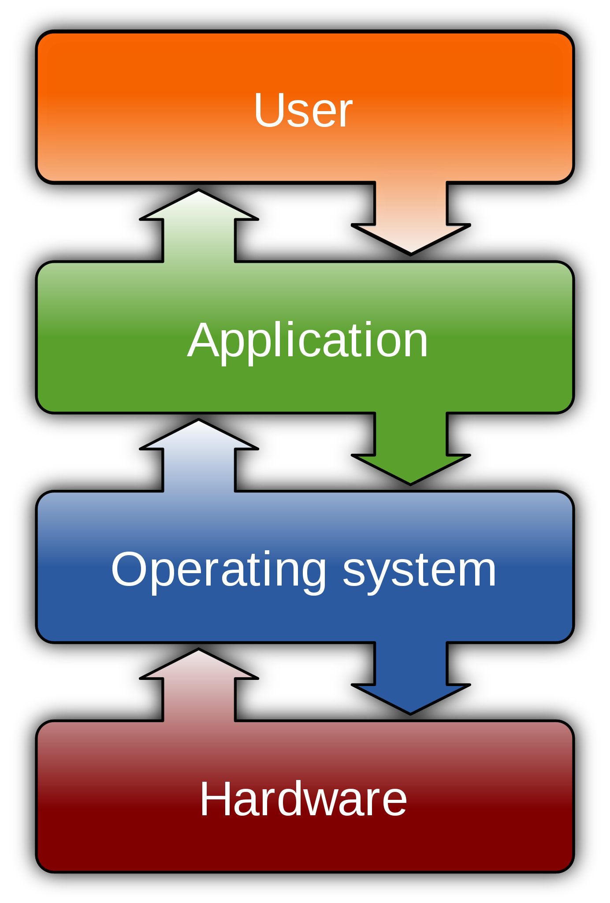
Operating System - Context
By Golftheman - Own work, CC BY-SA 3.0, https://commons.wikimedia.org/w/index.php?curid=4558519

Slide 12
Operating System - Context
By Golftheman - Own work, CC BY-SA 3.0, https://commons.wikimedia.org/w/index.php?curid=4558519

Slide 13
Operating System - Context
By Golftheman - Own work, CC BY-SA 3.0, https://commons.wikimedia.org/w/index.php?curid=4558519

Slide 14
Operating System - Context
By Golftheman - Own work, CC BY-SA 3.0, https://commons.wikimedia.org/w/index.php?curid=4558519

Slide 15
Linux
[WIKIPEDIA]: https://en.wikipedia.org/wiki/Linux [TUX]: https://en.wikipedia.org/wiki/Tux_(mascot)

Slide 16
Linux
“Linux is a family of open-source Unix-like operating systems first released on September 17, 1991 by Linus Torvalds.”
[WIKIPEDIA]: https://en.wikipedia.org/wiki/Linux [TUX]: https://en.wikipedia.org/wiki/Tux_(mascot)

Slide 17
Linux
“Linux is a family of open-source Unix-like? operating systems first released on September 17, 1991 by Linus Torvalds.”
[WIKIPEDIA]: https://en.wikipedia.org/wiki/Linux [TUX]: https://en.wikipedia.org/wiki/Tux_(mascot)

Slide 18
Linux
“Linux is a family of open-source Unix-like operating systems first released on September 17, 1991 by Linus Torvalds.”
[WIKIPEDIA]: https://en.wikipedia.org/wiki/Linux [TUX]: https://en.wikipedia.org/wiki/Tux_(mascot)

Slide 19
Linux
“Linux is a family of open-source Unix-like operating systems first released on September 17, 1991 by Linus Torvalds.”
This is Tux (see [TUX]) the mascot of Linux:
[WIKIPEDIA]: https://en.wikipedia.org/wiki/Linux [TUX]: https://en.wikipedia.org/wiki/Tux_(mascot)

Slide 20

Linux
“Linux is a family of open-source Unix-like operating systems first released on September 17, 1991 by Linus Torvalds.”
This is Tux (see [TUX]) the mascot of Linux:
[WIKIPEDIA]: https://en.wikipedia.org/wiki/Linux [TUX]: https://en.wikipedia.org/wiki/Tux_(mascot)

Slide 21
Linux Distribution
[DISTRIBUTION]: https://en.wikipedia.org/wiki/Linux_distribution [DEBIAN]: https://en.wikipedia.org/wiki/Debian [APT]: https://en.wikipedia.org/wiki/APT_(software) [RPM]: https://en.wikipedia.org/wiki/RPM_Package_Manager

Slide 22
Linux Distribution
“A Linux distribution (or distro) is an operating system
[DISTRIBUTION]: https://en.wikipedia.org/wiki/Linux_distribution [DEBIAN]: https://en.wikipedia.org/wiki/Debian [APT]: https://en.wikipedia.org/wiki/APT_(software) [RPM]: https://en.wikipedia.org/wiki/RPM_Package_Manager

Slide 23
Linux Distribution
“A Linux distribution (or distro) is an operating system made from a software collection that is based upon Linux
[DISTRIBUTION]: https://en.wikipedia.org/wiki/Linux_distribution [DEBIAN]: https://en.wikipedia.org/wiki/Debian [APT]: https://en.wikipedia.org/wiki/APT_(software) [RPM]: https://en.wikipedia.org/wiki/RPM_Package_Manager

Slide 24
Linux Distribution
“A Linux distribution (or distro) is an operating system made from a software collection that is based upon Linux and, often, a package management system.”
[DISTRIBUTION]: https://en.wikipedia.org/wiki/Linux_distribution [DEBIAN]: https://en.wikipedia.org/wiki/Debian [APT]: https://en.wikipedia.org/wiki/APT_(software) [RPM]: https://en.wikipedia.org/wiki/RPM_Package_Manager

Slide 25

Linux Distribution
“A Linux distribution (or distro) is an operating system made from a software collection that is based upon Linux and, often, a package management system.”
[DISTRIBUTION]: https://en.wikipedia.org/wiki/Linux_distribution [DEBIAN]: https://en.wikipedia.org/wiki/Debian [APT]: https://en.wikipedia.org/wiki/APT_(software) [RPM]: https://en.wikipedia.org/wiki/RPM_Package_Manager

Slide 26
Linux Distribution
“A Linux distribution (or distro) is an operating system made from a software collection that is based upon Linux and, often, a package management system.”
Common package management systems are introduced by debian (“apt”) and RedHat (“rpm”).
[DISTRIBUTION]: https://en.wikipedia.org/wiki/Linux_distribution [DEBIAN]: https://en.wikipedia.org/wiki/Debian [APT]: https://en.wikipedia.org/wiki/APT_(software) [RPM]: https://en.wikipedia.org/wiki/RPM_Package_Manager

Slide 27
Linux Distribution
“A Linux distribution (or distro) is an operating system made from a software collection that is based upon Linux and, often, a package management system.”
Common package management systems are introduced by debian (“apt”) and RedHat (“rpm”).
And Python has “pip”! :D
[DISTRIBUTION]: https://en.wikipedia.org/wiki/Linux_distribution [DEBIAN]: https://en.wikipedia.org/wiki/Debian [APT]: https://en.wikipedia.org/wiki/APT_(software) [RPM]: https://en.wikipedia.org/wiki/RPM_Package_Manager

Slide 28
The Shell

Slide 29
Shell
[WIKIPEDIA]: https://en.wikipedia.org/wiki/Unix_shell

Slide 30
Shell
“A Unix shell is a command-line interpreter or shell
[WIKIPEDIA]: https://en.wikipedia.org/wiki/Unix_shell

Slide 31
Shell
“A Unix shell is a command-line interpreter or shell that provides a command line user interface for Unix-like operating systems.
[WIKIPEDIA]: https://en.wikipedia.org/wiki/Unix_shell

Slide 32
Shell
“A Unix shell is a command-line interpreter or shell that provides a command line user interface for Unix-like operating systems. The shell is both an interactive command language and a scripting language
[WIKIPEDIA]: https://en.wikipedia.org/wiki/Unix_shell

Slide 33
Shell
“A Unix shell is a command-line interpreter or shell that provides a command line user interface for Unix-like operating systems. The shell is both an interactive command language and a scripting language, and is used by the operating system to control the execution of the system.
[WIKIPEDIA]: https://en.wikipedia.org/wiki/Unix_shell

Slide 34

Shell
“A Unix shell is a command-line interpreter or shell that provides a command line user interface for Unix-like operating systems. The shell is both an interactive command language and a scripting language, and is used by the operating system to control the execution of the system.
[WIKIPEDIA]: https://en.wikipedia.org/wiki/Unix_shell

Slide 35
Shell - Features
[WIKIPEDIA]: https://en.wikipedia.org/wiki/Unix_shell [BOURNE]: https://en.wikipedia.org/wiki/Bourne_shell [ZSH]: https://en.wikipedia.org/wiki/Z_shell

Slide 36
Shell - Features
Features of all Unix Shells
filename wildcarding
[WIKIPEDIA]: https://en.wikipedia.org/wiki/Unix_shell [BOURNE]: https://en.wikipedia.org/wiki/Bourne_shell [ZSH]: https://en.wikipedia.org/wiki/Z_shell

Slide 37
Shell - Features
Features of all Unix Shells
filename wildcarding
piping
[WIKIPEDIA]: https://en.wikipedia.org/wiki/Unix_shell [BOURNE]: https://en.wikipedia.org/wiki/Bourne_shell [ZSH]: https://en.wikipedia.org/wiki/Z_shell

Slide 38
Shell - Features
Features of all Unix Shells
filename wildcarding
piping
variables
conditional statements
iteration
[WIKIPEDIA]: https://en.wikipedia.org/wiki/Unix_shell [BOURNE]: https://en.wikipedia.org/wiki/Bourne_shell [ZSH]: https://en.wikipedia.org/wiki/Z_shell

Slide 39
Shell - Features
Features of all Unix Shells
filename wildcarding
piping
variables
conditional statements
iteration
There exist various shells, among them:
[WIKIPEDIA]: https://en.wikipedia.org/wiki/Unix_shell [BOURNE]: https://en.wikipedia.org/wiki/Bourne_shell [ZSH]: https://en.wikipedia.org/wiki/Z_shell

Slide 40
Shell - Features
Features of all Unix Shells
filename wildcarding
piping
variables
conditional statements
iteration
There exist various shells, among them:
Bash (Bourne-Again shell; bash) default on most Linux systems
Z shell (zsh) default on macOS since 10.15 Catalina
[WIKIPEDIA]: https://en.wikipedia.org/wiki/Unix_shell [BOURNE]: https://en.wikipedia.org/wiki/Bourne_shell [ZSH]: https://en.wikipedia.org/wiki/Z_shell

Slide 41

THANK YOU
Contact Details
DCI Digital Career Institute gGmbH

